Slide 1
Maven 2023
Amir Dirin

Slide 2
What is Maven
Two scenarios drove Maven to us:
As a Java developer who is involved with building the application. Like to be able to reuse the build scripts, as simple as making a Java API call.
As a project manager/team lead who is trying to keep up-to-date with interdependencies among components.

Slide 3
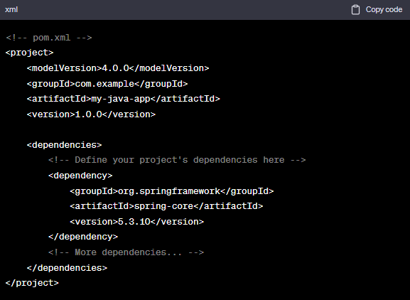
Scenario 1 Java developers perspective
Reuse the build scripts easily as simple as Java API call
Suppose you have a Java project, and you need to build it. With Maven, you can create a pom.xml (Project Object Model) file that describes your project's dependencies and build configuration. This file acts as your "build script."
Then, as a Java developer, you can simply run Maven commands like mvn clean install or mvn package to build and package your application. Maven handles the complexity of downloading dependencies and running the build process. It's as simple as making an API call to build your project.

Slide 4
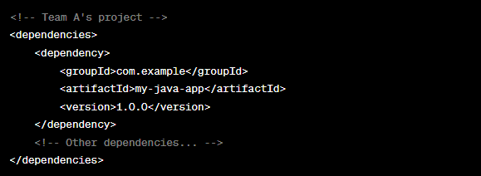
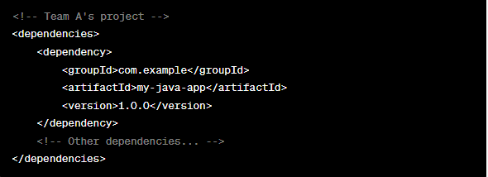
Scenario 2: Project Manager/Team Lead Using Maven
Maven helps managers to keep up-to-date with inter-dependencies among components
Imagine you're overseeing a project with multiple teams working on different components. Each team uses Maven to manage their project's dependencies. You can easily track these dependencies through the pom.xml files in each project.
As a project manager, you can review these pom.xml files to see how different components depend on each other. If Team A decides to update their component's version, you'll know that it may impact Team B's work. This allows you to keep up-to-date with inter-dependencies among components and make informed decisions regarding project coordination and timelines.

Slide 5
Maven?
Mostly used as a build tool for Java projects
It is more than a build tool
Project Object Model (POM)
Project lifecycles
Dependency management
Plugin framework
Maven helps in getting the right JAR files for each project as there may be different versions of separate packages.
To download dependencies it is no more needed to visit the official website of each software.
It is enough to visit mvnrepository.com

Slide 6
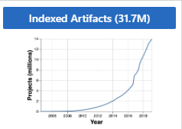
What is MVN
Open-source build tool developed by the Apache Group to build, publish, and deploy several projects at once
MVN is written in Java and is used to build project written in C#, Scala, Ruby, etc.

Slide 7
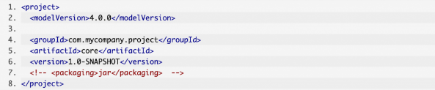
pom.xml and model Version
MVN is based on Project Object Model (POM) and focus on simplification and standardization of the building process
pom.xml is a description of the project
In the process POM takes care of the following
Build
Dependencies
Report
Distribution
Releases
Mailing list

Slide 8
Maven Coordinates
groupId
Name of the company, organization, team etc., usually using the reverse URL naming convention
artifactId
A unique name for the project under groupId
version
packaging, default: jar
classifier
Maven coordinates uniquely identifies a project.

Slide 9
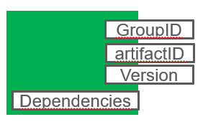
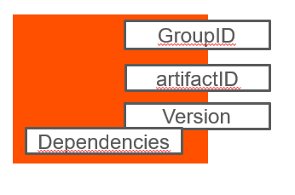
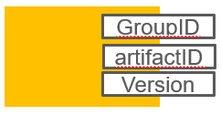
Convention Over Configuration
Systems, libraries, and frameworks should assume reasonable defaults.
Making the artifact
inheritance
<parent>
</parent>
<modelVersion>4.0.0</modelVersion>
<groupId>Junit_Maven_har4</groupId>
<artifactId>Junit_maven_har</artifactId>
<version>0.0.1-SNAPSHOT</version>
Build is inprogress

Slide 10
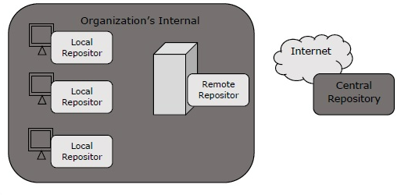
MVN Repository
MVN repositories refer to the directories of packaged JAR that contain metadata (POM). The metadata allow to download dependencies.
Three types of reposotories
Local repo
Remote repo (e.g,, developer’s own custome repo)
Central repo (e.g., provided by Maven community)

Slide 11
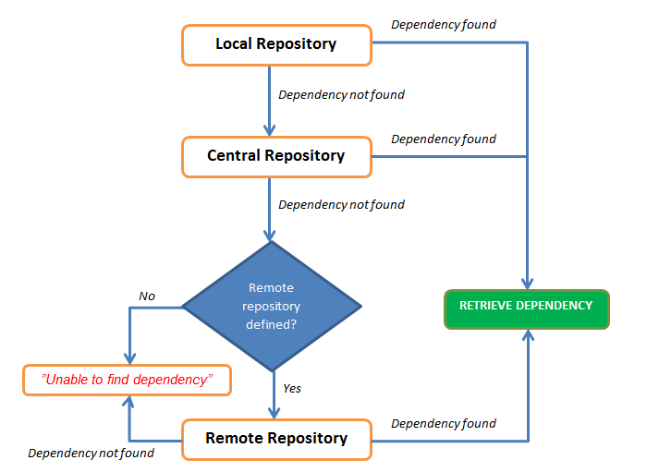
Dependencies Search
<!-- https://mvnrepository.com/artifact/junit/junit -->
<dependency>
<groupId>junit</groupId>
<artifactId>junit</artifactId>
<version>4.8.1</version>
<scope>test</scope>
</dependency>

Slide 12
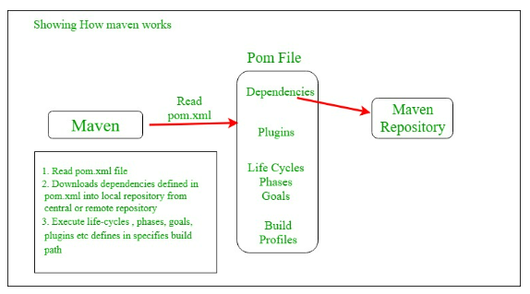
Maven Architecture
Read POM.xml file
Download dependencies defined in pom.xml into local repo from central repo
Create and generate a report according to the requirements, and execute life-cycles phases, goals, plugins etc.

Slide 13
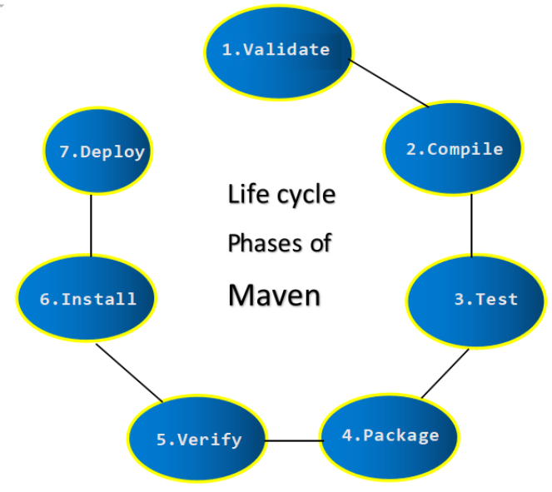
Build life-cycle
The process for building and distributing a project
A build lifecycle consists of a number of steps called
Validation of project is done (e.g., all needed data is avaliable)
Compile, error checking
Test the compiled source code using unit testing
Package, compiled file mereged into package
Verigy the integration to ensure the quality
Install the packages in our local repo which can be used for other local projects.
Depoly a copy of the final packge to the remote repo for sharing with team

Slide 14
Default Directory Structure
src/main/java
src/main/resources for files that should be placed under classpath
src/main/webapp for web applications
src/test/java
target

Slide 15
Default Directory Structure
Repository for JAR files for connectivities with third parties…
You do not need to download all the

Slide 16
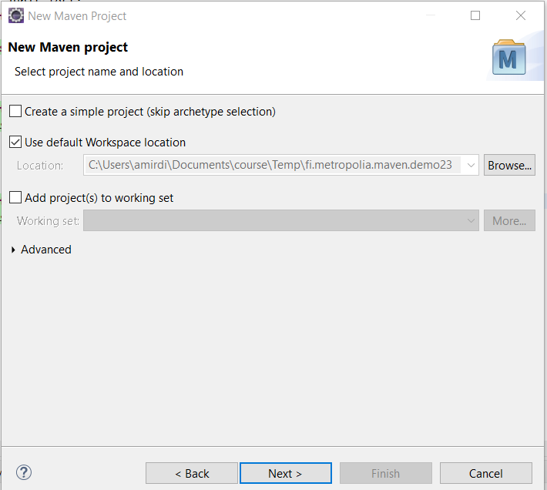
In Eclipse
Select this option
Select New → Other→Maven Project

Slide 17
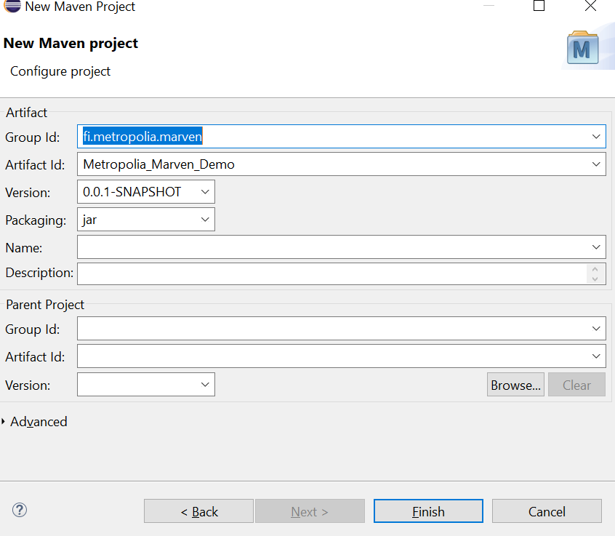
Example (Eclipse)
Name of the package

Slide 18
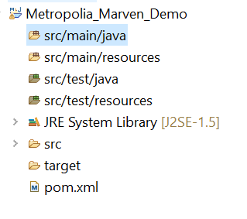
File
Right-click and select add a new class.
Add the name and ids e.g., fi.metro.maven
And package name (if needed depends on IDE)

Slide 19
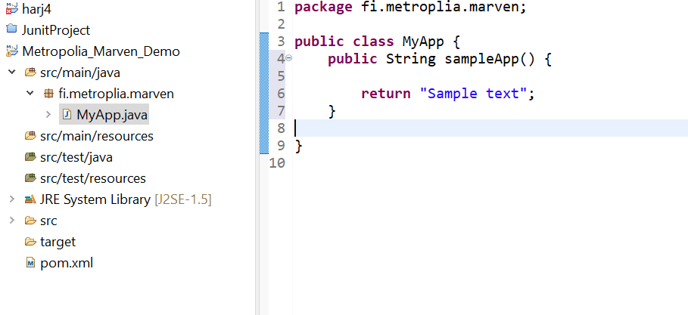
W

Slide 20
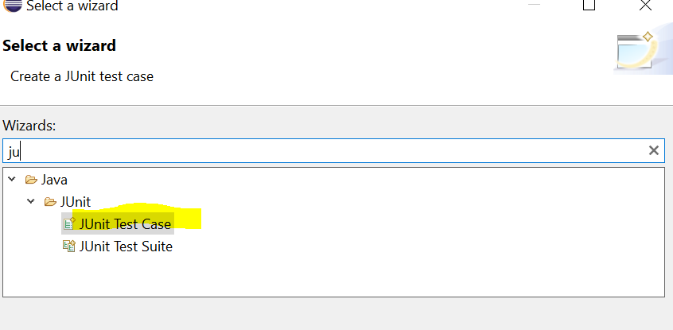
Test Category
Go to the
Add a Junit class using Wizard or create a Java class and add the respective import in the file

Slide 21
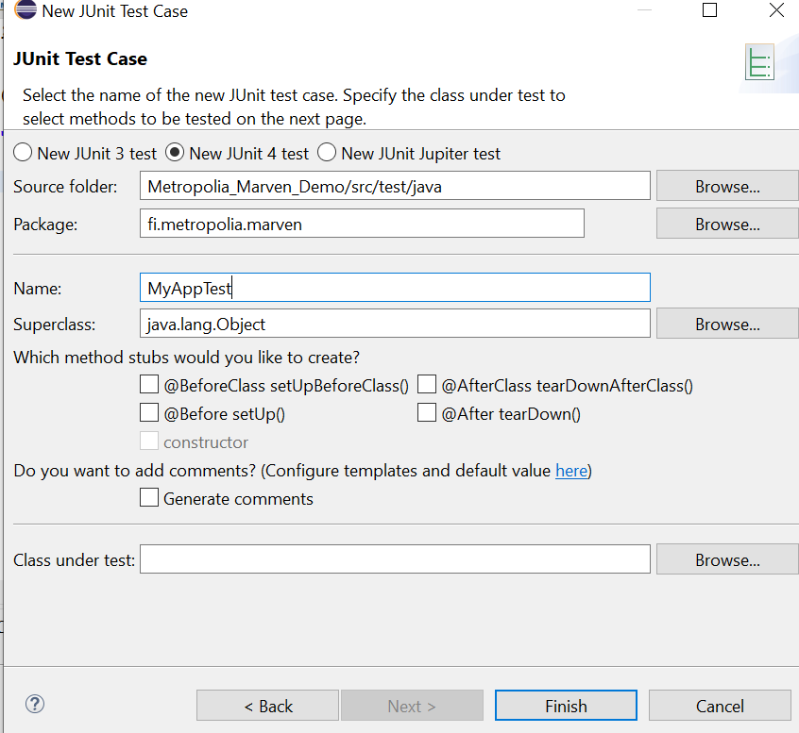
New Junit test case wizard

Slide 22
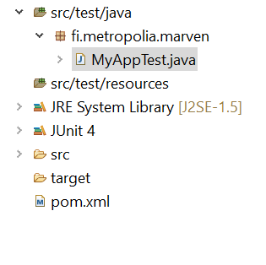
Dependencies
<dependencies>
<dependency> <groupId>junit</groupId> <artifactId>junit</artifactId> <version>4.12</version> <scope>test</scope> </dependency> </dependencies>

Slide 23
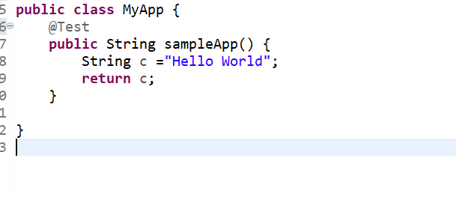
Testing
Add the library @Test
And Cross over Mouse ”add the respective imports ”

Slide 24
Lecture Exercise
Create a Maven project and develop JUnit test for the main class that assess the main class performance

Slide 25
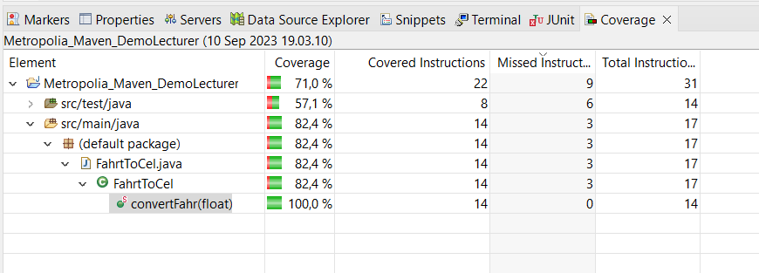
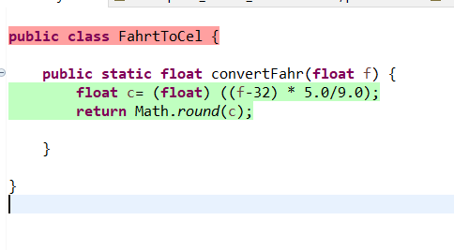
Lecture assignment
Create a Maven project to convert Fahrenheit to Celsius.
For example, 32 Fahrenheit
C=5/9*(F-32)
(32F-32)*5/9 = 0C

Slide 26
For Python
In Python PIP is used for managing dependencies and setuptools for package distribution. You can use virtualenv or Venv for creating isolated Python environments.
PIP: it’s used to install Python packages from the Python Package Index (PyPI) and manage project dependencies
Setuptools: it’s used to package Python projects for distribution, create distribution archives, and handle installation.
Virtualenv or venv: These tools help create isolated Python environments allowing you to manage dependencies separately for different project

Slide 27
Node.JS
In the Node.js ecosystem, npm (Node Package Manager) is the primary tool for managing dependencies and project lifecycles. package.json is the equivalent of a Maven pom.xml in Node.js.
npm: Used for installing Node.js packages and managing project dependencies. It also handles tasks like running scripts defined in the package.json file.
package.json: Similar to a pom.xml, it defines project metadata, dependencies, and scripts for various project tasks.

Slide 28
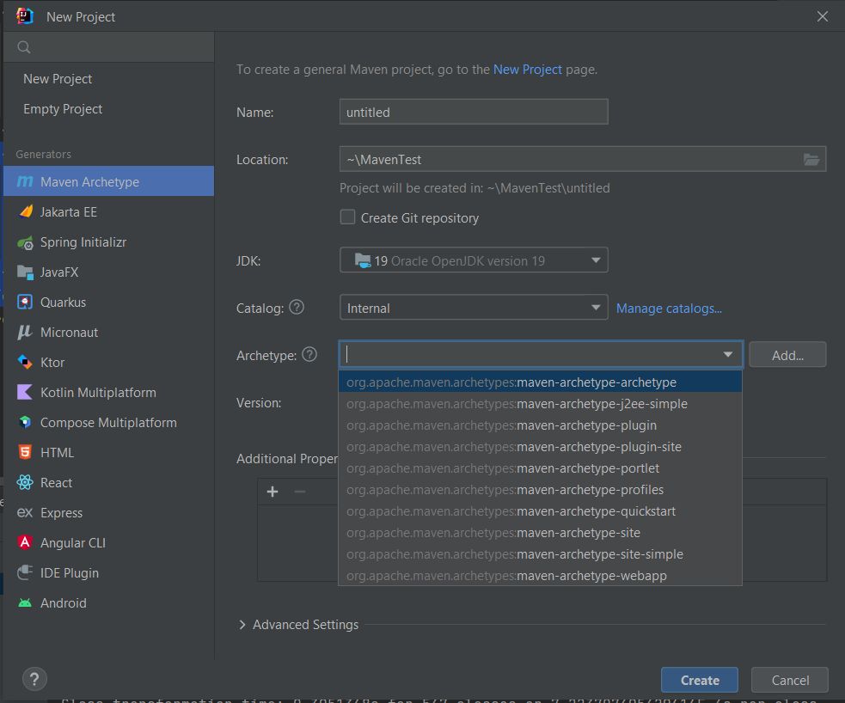
IntelliJ
New→ Project→Maven project
Select quickstart for archetype
C:\Users\amirdi\MavenTest

